Slide 1

Threat Modeling Workshop

Slide 2
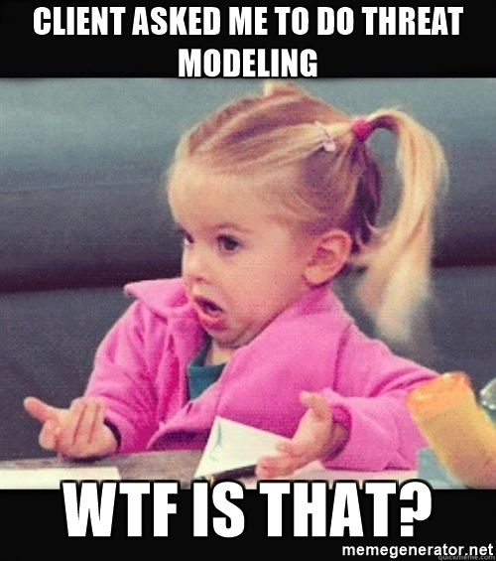
?
What is
… Threat Modeling

Slide 3


Threat modeling is a structured representation of all the information that affects the security of a system ➔ works to identify, communicate, and understand threats and mitigations within the context of protecting something of value

Slide 4

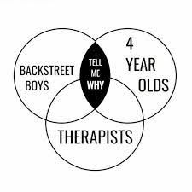
Why is Threat Modeling required ?
Startingpoint to recognize „what can go wrong in a System“
Allows to design and create mitigation in an early lifetime of a system
The threats (part of the output) document the made decisions regarding your subsequent design, development, testing, and post-deployment phases

Slide 5
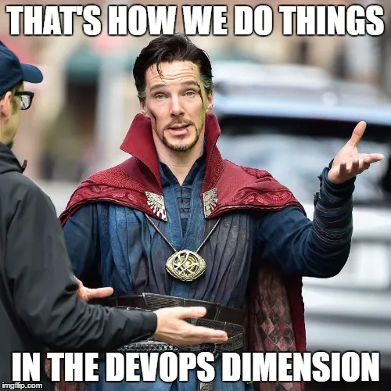
?
How can I
… create a Threat Model

Slide 6

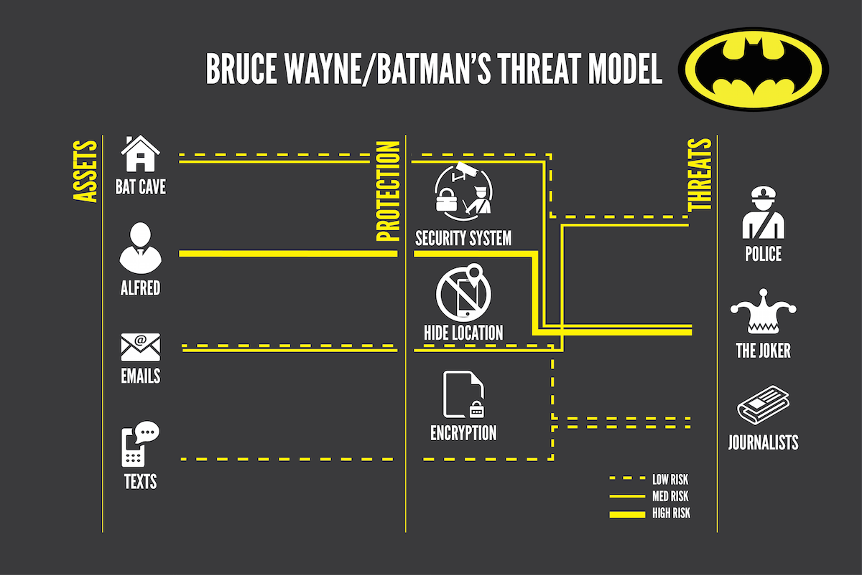

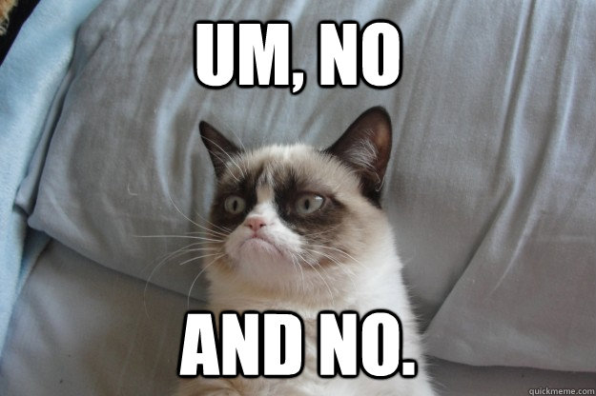
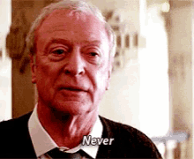

Slide 7
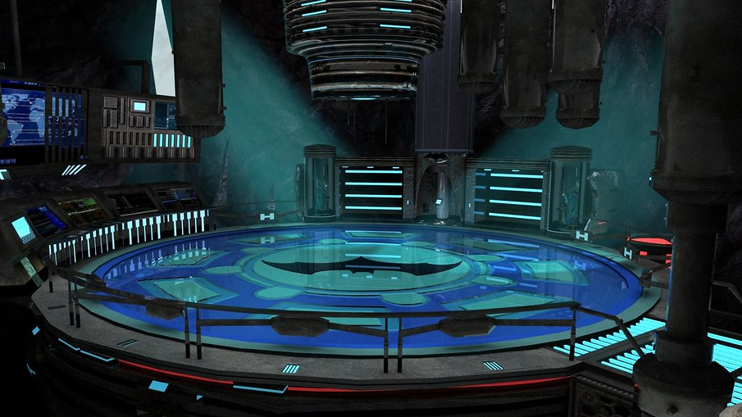
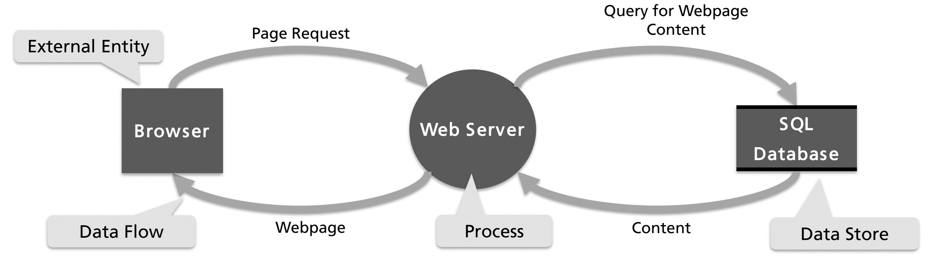
External Entity
Data Flow
Process
Data Store
A threat model is NOT
an architectural model of the system!
NO complete architecture diagram
Threat Modeling focuses on data flow
Te
Te

Slide 8
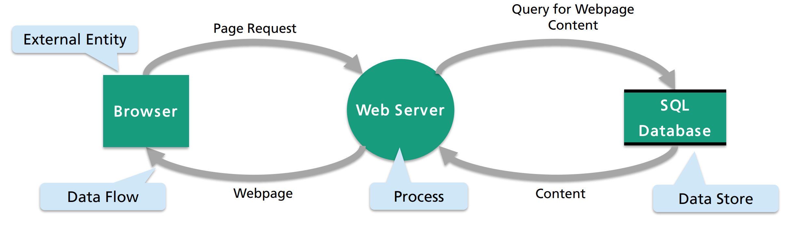
External Entity
Data Flow
Process
Data Store
External Entity - e.g., clients, other systems, dependencies
Data Flow - Domain-specific explanation of data e.g., “Login Requests“
Process - Architecture-centered functionality e.g., dispatcher, input validator
Data Store - e.g., database, file system
Te

Slide 9
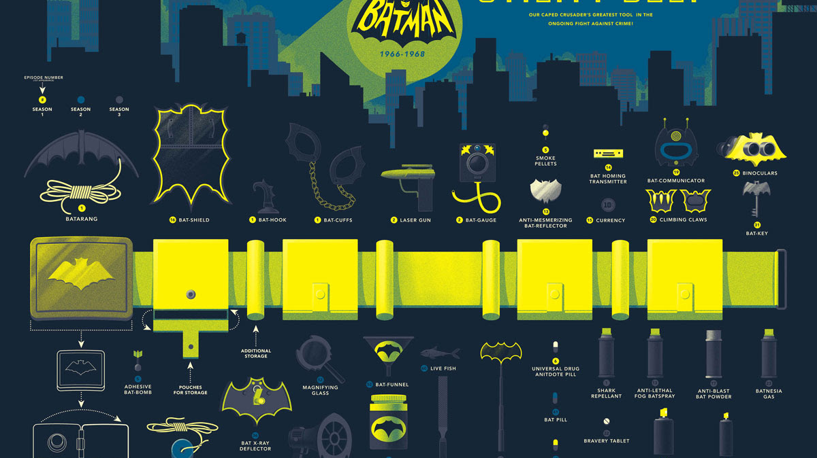


Wait – where are the Security aspects ?

Slide 10
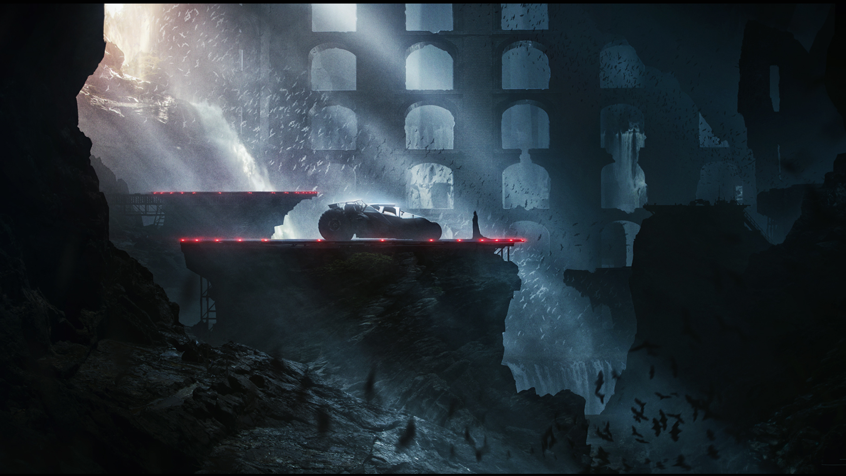
Trust Boundaries
Draw trust boundaries: Data from one party to another is NOT trusted
Untrusted examples:
Data from a web browser (e.g., external entity)
Data from one machine to another
Trusted examples
Data from another process within the same runtime environment
Data from your own database

Slide 11

Trust Boundaries
Where should the trust boundary be ???
External Entity
Data Flow
Process
Data Store

Slide 12


Trust Boundaries
We have two parties here: A Browser and a Web Application
Communication with a Browser might be malicious ➔ untrusted
We own the Web Server and SQL Database ➔ trusted
External Entity
Data Flow
Process
Data Store

Slide 14
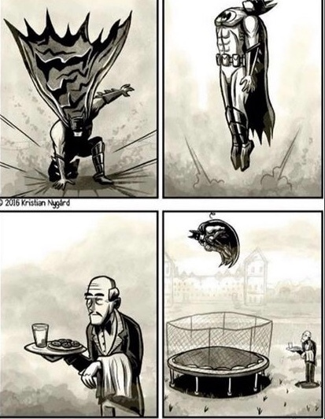
?
How can
… I start, train and improve my threat modeling skills

Slide 15

You can always start …
With your next user story or epic
Model your existing system as one component > Model ONLY the new components in detail
Focus on which new threats occur?
When ever you implement your next user story…
…ask yourself:
Do we change assets, external entities, proccess, datastores or –flows?
Do we change or provide a new interface (to the outside)?
Have attacks become easier by new flaws ?

Slide 16
Naming is HUGE
Make your flows meaningful
Bad: „HTTP“, „Request“
Good: „Scrape result“ „Login Form“
Name your trust boundaries
DMZ? Corporate Network? Machine?
Processes & external interactors
Bad: „server“
Good: „udemy.com“
HTTP Request
Page Request
Web Server
Browser
Ultimate test Colleagues and Security guys should understand your system without much other info than the data flow diagram you presnet them
Webpage

Slide 17

Final tips before you start
Be honest with the process
Make sure the modes represents reality
Consider all types of threats
Threat Modeling is a teamwork task ➔ Get diverse and leave your silo
Trust boundaries are a good starting point for finding threats BUT „trust“ is sometimes hard to achive ➔ Chance the perspective on the business side and stop talking only about techie stuff
As with all modelling: „use approperiate complexity“
Too simple? ➔ Your model may depart from reality
Too complex? Too much to analyze ➔ Divide & Conquer!

Slide 18
Final tips before you start
Be honest with the process
Make sure the modes represents reality
Consider all types of threats (it‘s not always the technical stuff)
Threat Modeling is a teamwork task ➔ Get diverse and leave your silo
Trust boundaries are a good starting point for finding threats BUT „trust“ is sometimes hard to achive ➔ Chance the perspective on the business side and stop talking about techie stuff
As with all modelling > use approperiate complexity
Too simple? ➔ your model may depart from reality
Too complex? Too much to analyze ➔ Divide & Conquer!

Slide 19

Tools for Threat Modeling
UI / Graphical painting tools
Draw.io Custom Templates
MSTMT App (Microsoft Threat Modeling Tool)
Threat Modeling Worksheet
Threat Modeling As Code
pyTM
Threagile.io

Slide 20

!
Show me
… a real example

Slide 21

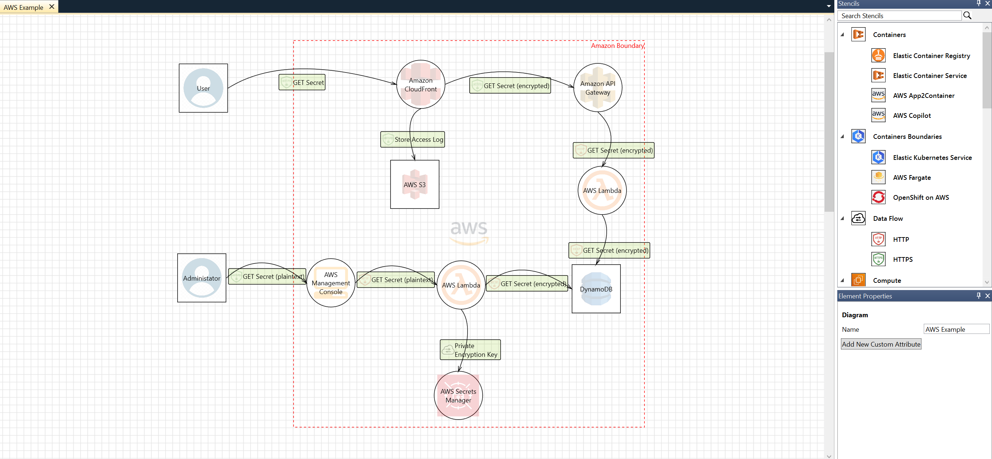

Slide 22
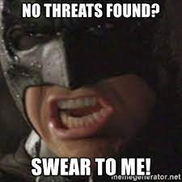

?
How can
… I find and cluster threats

Slide 23

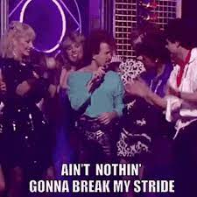
Use a Framework like:
Octave, Trike and STRIDE
to identifying and model Security Threats

Slide 24
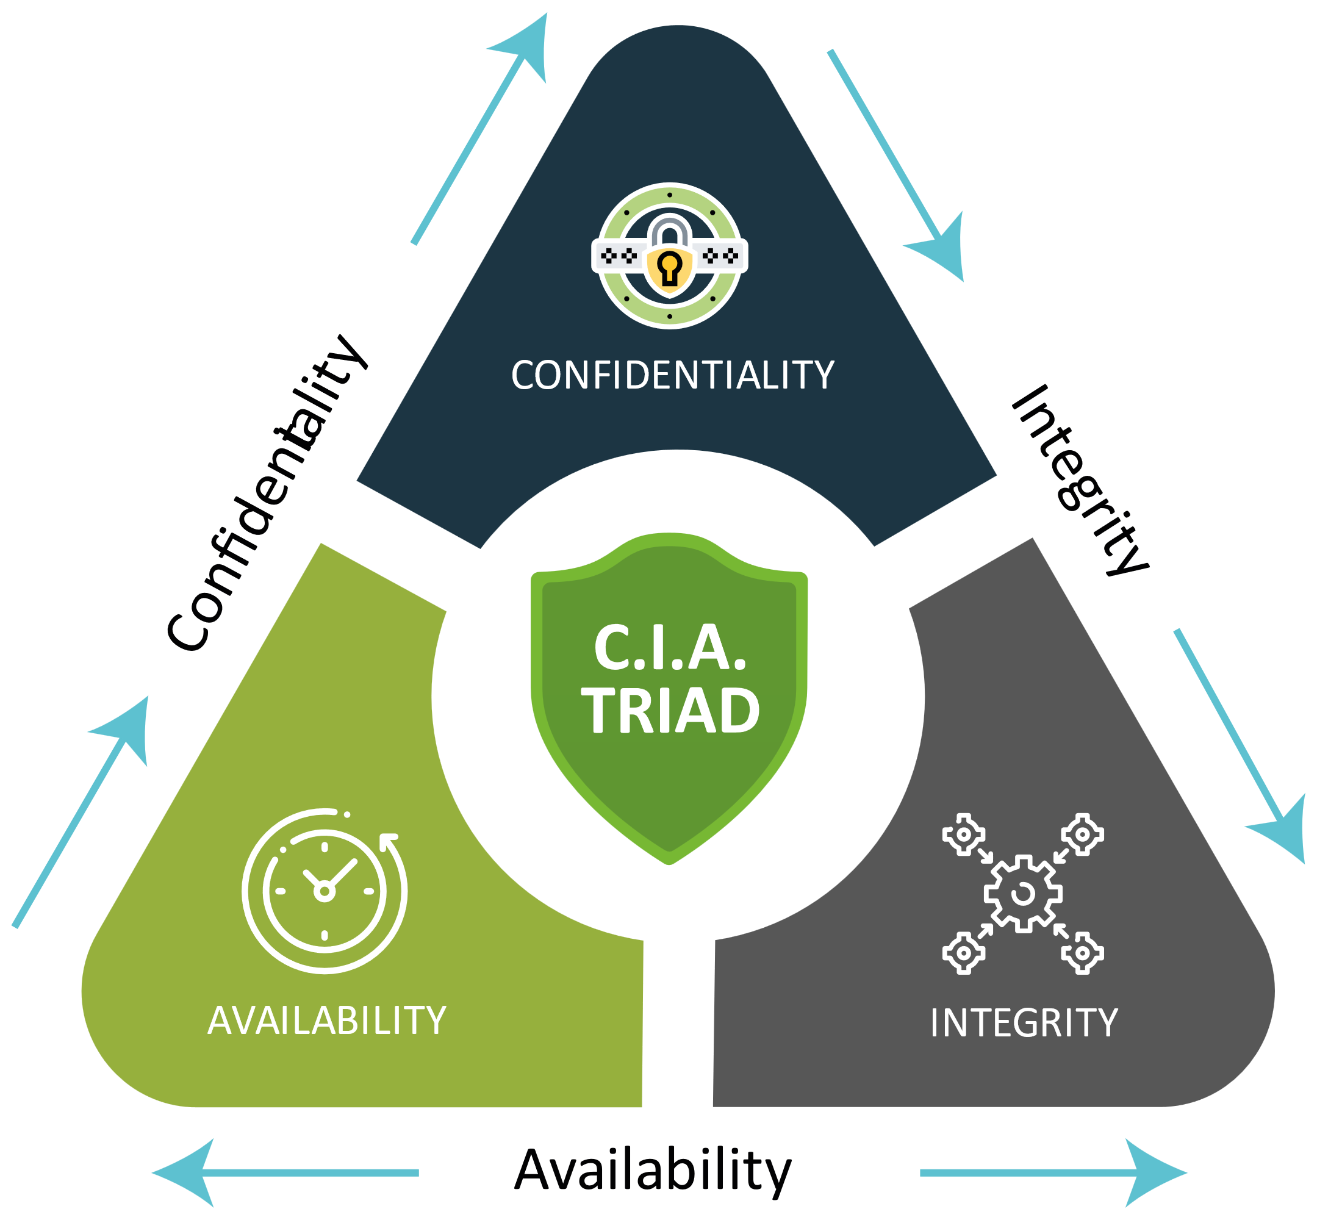
STRIDE Framework
Spoofing
Can an attacker gain access using a false identity?
Tempering Can an attacker modify data as it flows through the application?
Repudiation If an attacker denies doing something, can we prove he did it?
Information disclosure Can an attacker gain access to private or potentially injurious data?
Denial of Service Can an crash or reduce the availability of the system?
Elevation of Privilege
Can an attacker assume the identity of a privileged user?

Slide 25
Let‘s Combine Threat Modeling elements with the STRIDE Framework
Threat Model Element | Example | S | T | R | I | D | E
External Entity | Browser | ✅ |  | ✅ | ✅ | ✅
Process | Web Server | ✅ | ✅ | ✅ | ✅ | ✅ | ✅
Data Store | SQL Database |  | ✅ | 🗸 | ✅ | ✅
Data Flow | - |  | ✅ | ✅ | ✅

Slide 26
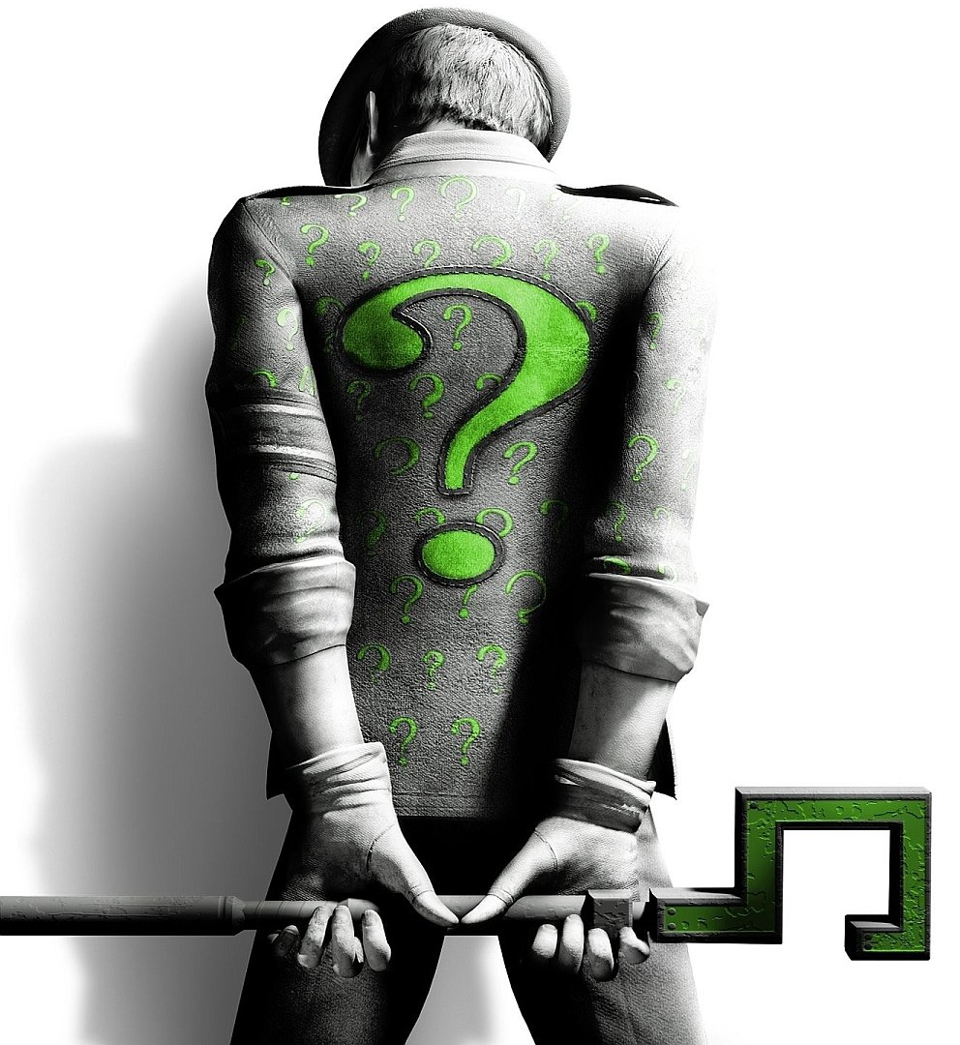
Can you map the Threat with the correct STRIDE category ?
Persons other than the one who registered a Covestro Azure account obtain the credentials and log into said account.
Upload of a PDF is temporarily unavailable due to HDD space running out
A modified request gets sent to SAP and changes other customers’ contract data.
Changes to a customer’s contract data cannot be reliably traced back to the customer

Slide 27
Can you map the Threat with the correct STRIDE category ?
Persons other than the one who registered a Covestro Azure account obtain the credentials and log into said account.
Spoofing
Upload of a PDF is temporarily unavailable due to HDD space running out
Denial of Service
A modified request gets sent to SAP and changes other customers’ contract data.
Tampering
Changes to a customer’s contract data cannot be reliably traced back to the customer
Repudiation

Slide 28

?
How can
… the found Threats be Ranked

Slide 29
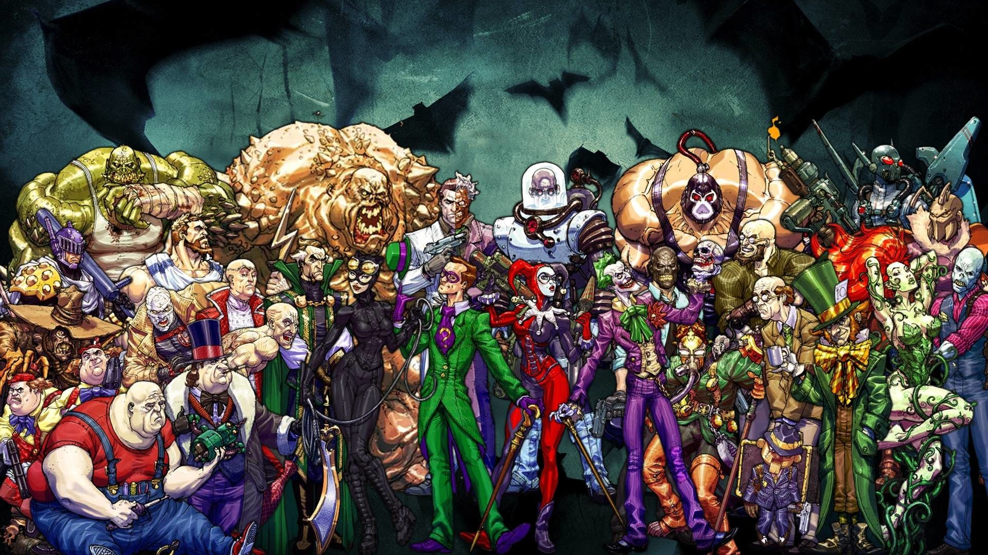
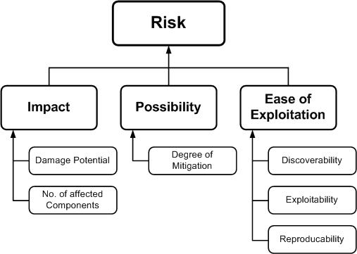
Ranking of Threats
Apply ranking from the perspective of risk factors
Priorize Threats by determine the risk factors by the various identified threats
Rank by „High, Medium, or Low risk“
Casual risk models use different factors to model risks, like shown below

Slide 30

DREAD Risk Assessment Model
Like STRIDE created by Microsoft
Provides a subjective process to rank threats
Risk factorization allows the assignment of values to the different influencing factors of a threat

Slide 31
DREAD Risk Assessment Model
Uses a point system of numbers 1-10 ➔ represent low to high severity to calculate the DREAD Score
Damage How big would the damage be if the attack succeeded?
Reproducibility How easy is it to reproduce an attack?
Exploitability How much time, effort, and expertise is needed to exploit the threat?
Affected Users If a threat were exploited, what percentage of users would be affected?
Discoverability How easy is it for an attacker to discover this threat?

Slide 32
DREAD Risk Assessment Model
Example Threat: Malicious user views confidential information of students, faculty members and librarians.
Damage potential: Threat to reputation as well as financial and legal liability (8)
Reproducibility: Fully reproducible (10)
Exploitability: Require to be on the same subnet or have compromised a router (7)
Affected users: Affects all users (10)
Discoverability: Can be found out easily (10)
Let’s sum it up, overall DREAD score for this threat: (8+10+7+10+10) / 5 = 9

Slide 33

Exercise
Define teams of 4 people
You have 20 minutes:
Create a threat model incl. trust boundaries for the scenario on the next slide
Use what ever helps you the most like: pen & paper, draw.io, or Microsoft Threat Modeling Tool
One team shall present its results
Discussion follow up with the whole group

Slide 34

Scenario
The system consists of a Wayne Enterprises web application called “totallyNOTbatman” that can access web pages stored in a relational database. Through a web browser, via internet, customers can provide credentials to the web application and get a response with their data.
In the Wayne Enterprises corporate network, there is a frontend management system that can provide customer data to the web application on request. The frontend management system logs all actions in a logging data sink.
The customer data is provided by the backend management system and has its own database. The frontend management system can request customer data from the backend management system.

Slide 35

Happy Threat Modeling

